Slide 1

SAP ARCHITECTURE
- Abhay Singh, Employee

Slide 2
Overview
History of SAP Architecture
R/3 Tier Architecture

Slide 3
History of SAP ARCHITECTURE
1972
Release of R/1 System RF Accounting System.
Based on 1-tier architecture.
Financial Accounting System.
Runs on IBM Servers and the DOS Operating System.

Slide 4
History of SAP ARCHITECTURE
1972
1979
Release of R/2 Mainframe System.
Based on 2-tier architecture.
Mainframe based real-time data processing across accounting, manufacturing processes, supply chain logistics, and human resources.

Slide 5
History of SAP ARCHITECTURE
1972
1979
1992
Release of SAP R/3 Enterprise Edition 1.0A
Three tire architecture ERP Solutions, enabling SAP to be used by enterprises.

Slide 6
R/3 Tier Architecture
R/3 Tier Architecture
Presentation Layer
Application Layer
Database Layer

Slide 7

R/3 Tier Architecture
Database Layer
Database Layer
Database Server
Database Management System

Slide 8
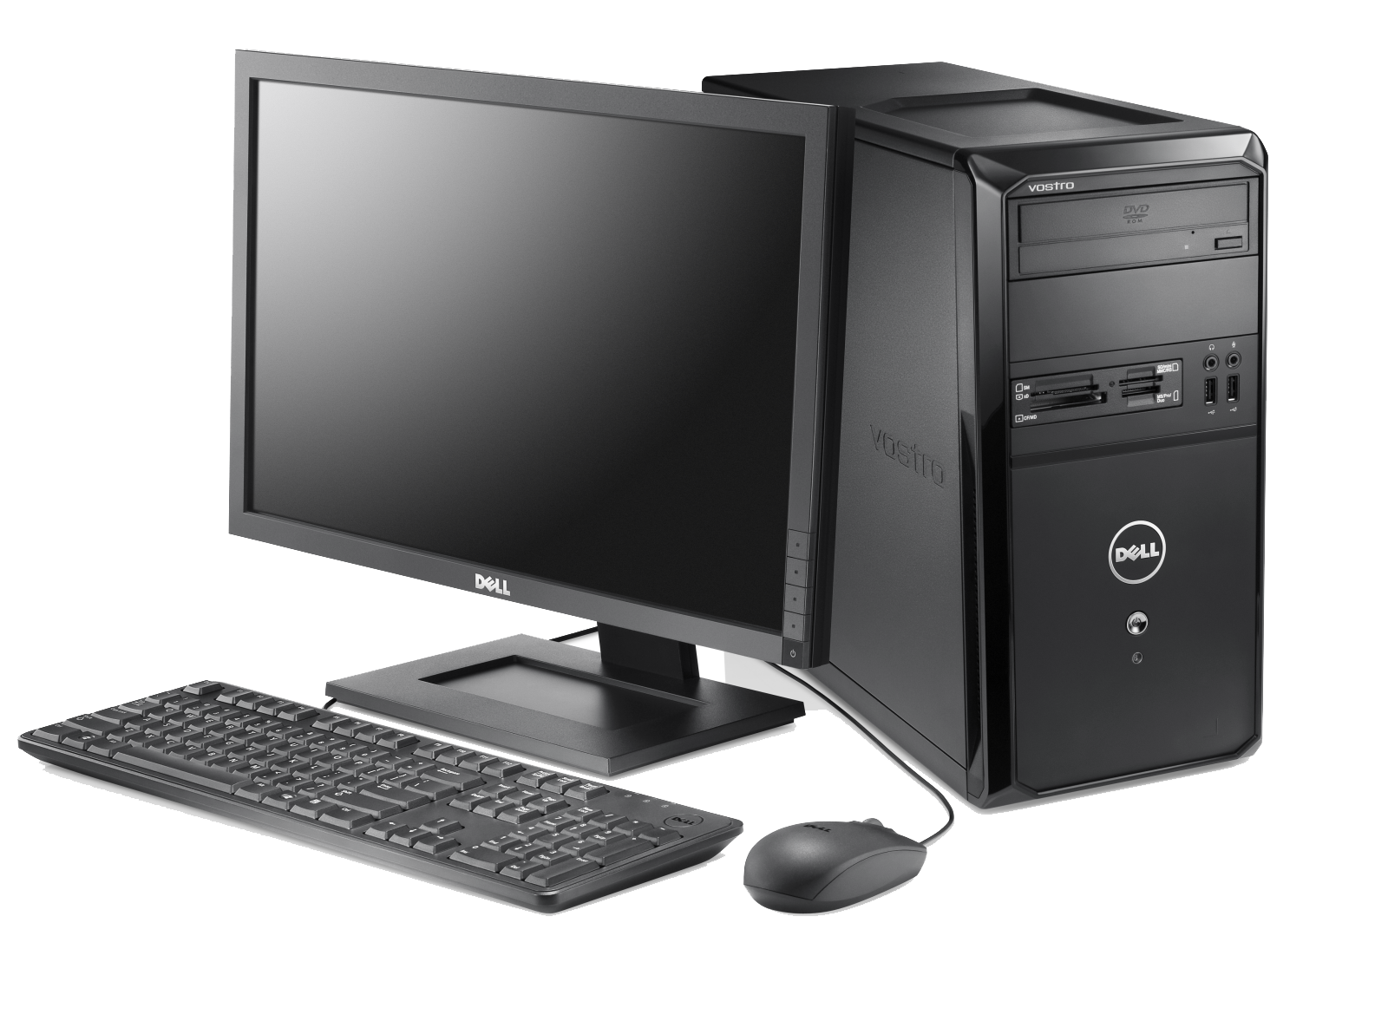
R/3 Tier Architecture
Database Layer
Application Layer
Application Layer
Presentation Layer
Application Server
Application Layer
Message Server
Database Layer

Slide 9
R/3 Tier Architecture
Database Layer
Application Layer
Application Server
Presentation Layer
Work Process
Database Layer
Dispatcher

Slide 10
R/3 Tier Architecture
Database Layer
Application Layer
SAP GUI
SAP GUI
ABAP Application server
Request Queues
Dispatcher
Shared Memory
Work area
context
Work area
context
Database Management System
Database

Slide 11
R/3 Tier Architecture
Database Layer
Application Layer
Presentation Layer
Presentation Layer
SAP GUI

Slide 12
Thank You

